Slide 1
Class diagramms: essentials
A class diagram describes the types of objects in the system and the various kinds of static relationships that exist among them.
Fowler, Martin. UML Distilled: A Brief Guide to the Standard Object Modeling Language (3rd ed.).

Slide 2
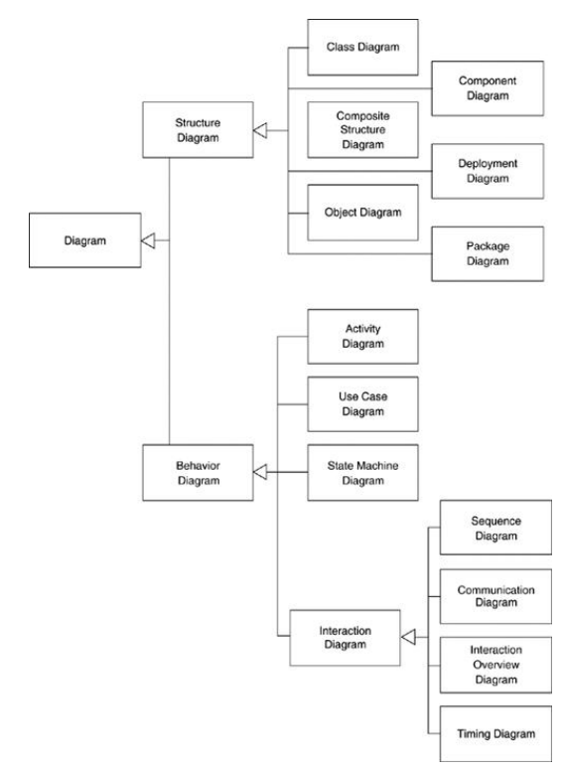

Slide 3
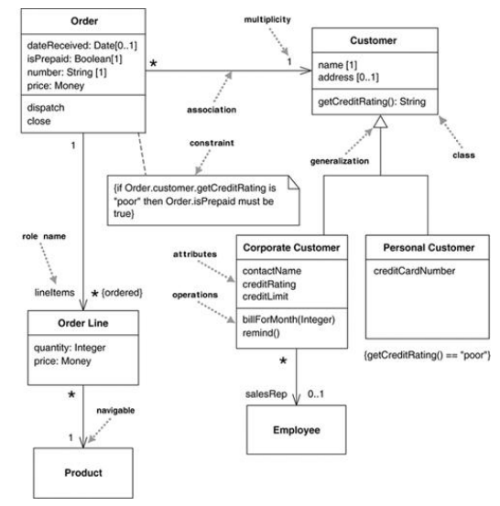
Simple class diagram

Slide 4
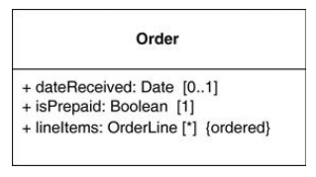
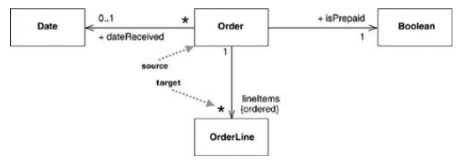
Associations
or

Slide 5
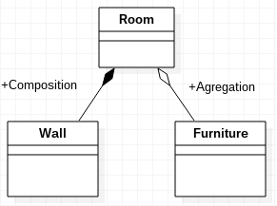

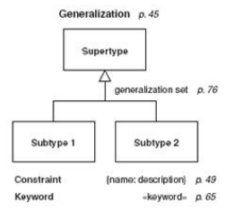
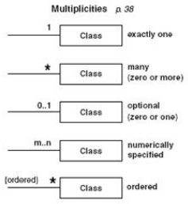
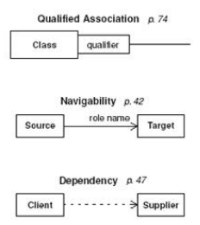
Associations

Slide 6
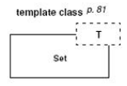

Associations

Slide 7

Bidirectional Associations
cars:Car[*]
owner:Person[1]

Slide 8
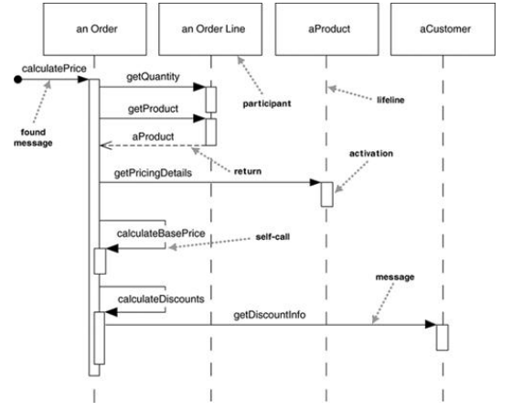
Sequence diagram. Centrilized control

Slide 9
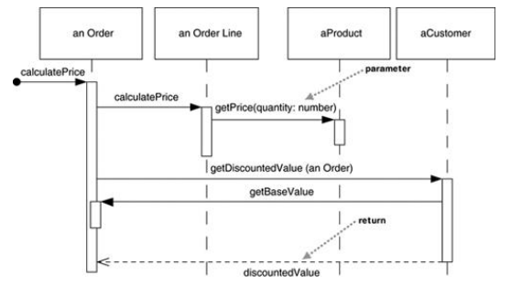
Sequence diagram. Distributed control

Slide 10
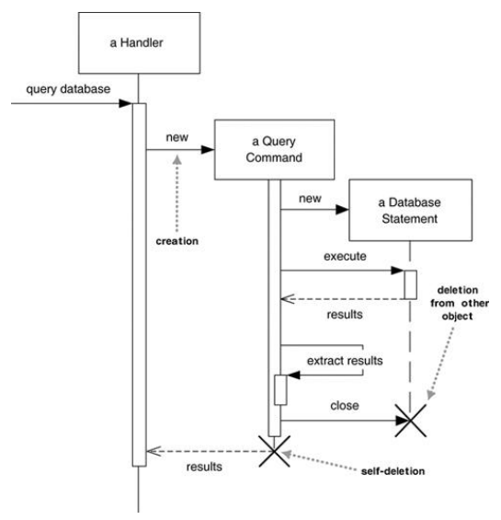
Sequence diagram. Creation, deletion

Slide 11
Sequence diagram. Distributed control

Slide 12
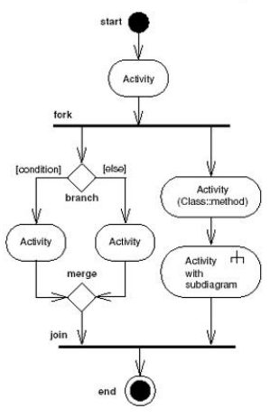
Activity diagram

Slide 13
Use Case | Description
Authenticate candidate | Using candidate’s information, administrator check for candidate’s eligibility
Register candidate | Administrator register eligible candidates to the system.
Log in Candidate | Using the username, password and the identification number, candidates can log in to the voting system.
Update candidate information. | Update existing information.
Lookup candidate | Using candidate name, find candidate information, election headquarter, and the election district a candidate is enrolled in.
Authenticate voter | Using voter’s information, administrator check for voter’s eligibility
Register voter | Administrator register eligible candidates to the system.
Log in voter | Using the username, password and the identification number, voter can log in to the voting system.
Update voter information | Update voter existing information
Lookup election type | Find the election type you want to participate in.
Lookup election district | Using district name, find candidate names who are enrolled to a specific district
Submitting a vote | Voter can cast his/her vote.
View results | Using the election information, show the final results and the number of votes each candidate has received.

Slide 14
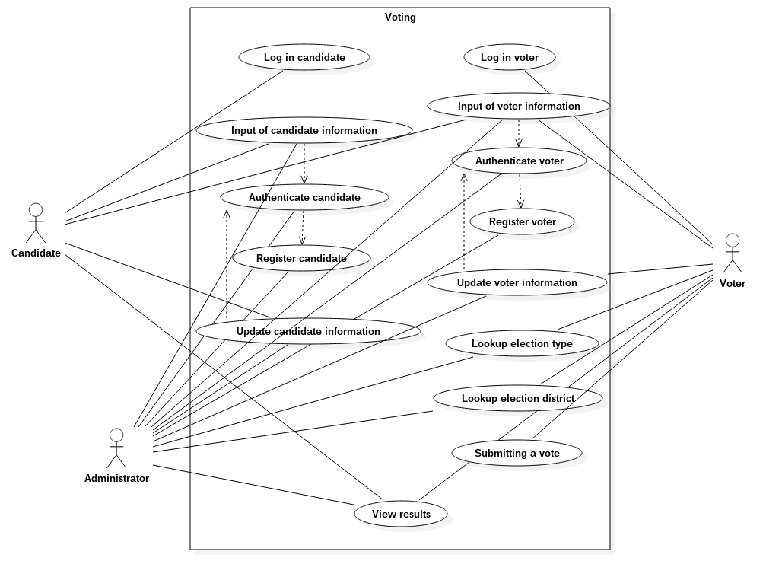

Slide 15
Object Classes | Attributes
Candidate | Candidate name, identification number, password, constituency id, headquarter address, phone, and email
Voter | Voter name, identification number, password, constituency, email, phone
Administrator | Admin name, identification number, password
Cast vote | Voter id, candidate id, constituency id, submit vote, cancel vote
Consistuency | Consistuency name, identification number
Voting server | Candidate id, voter id, constituency id, votes count, reports production
Results | Candidate id, constituency id, votes count, display

Slide 16
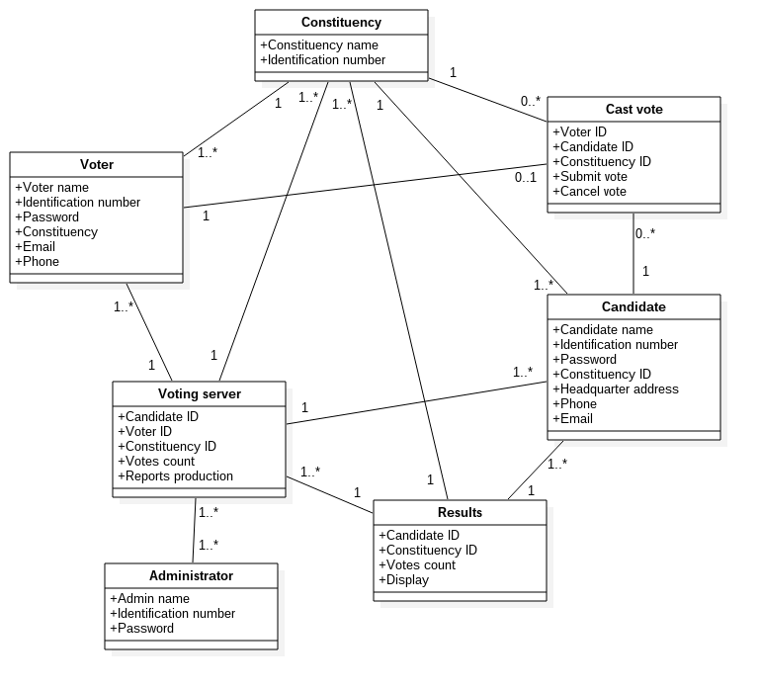

Slide 17
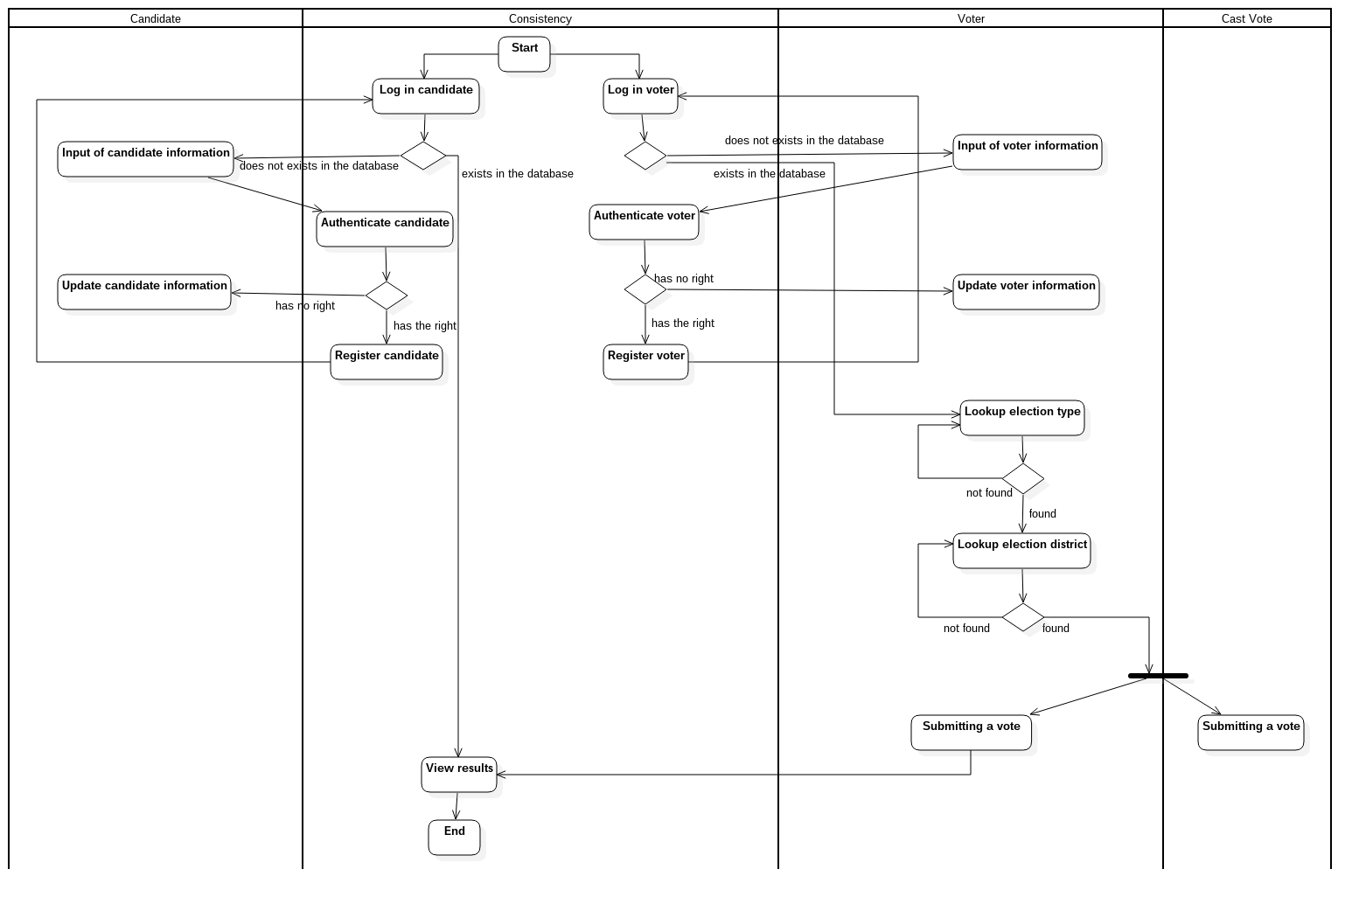

Slide 18
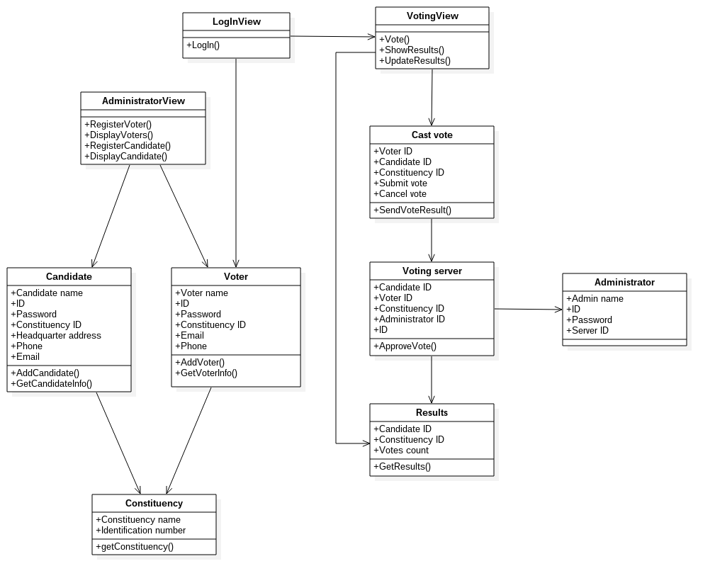

Slide 19
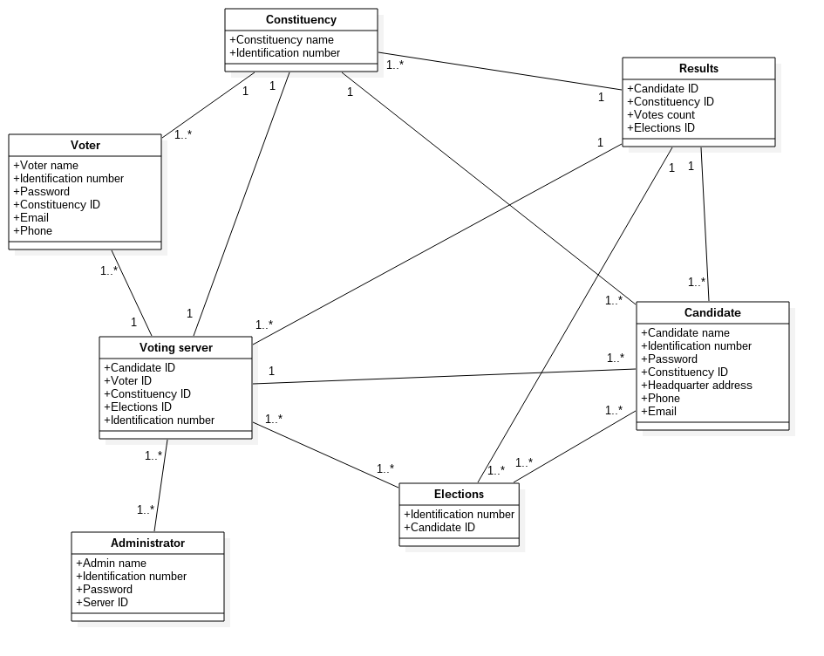

Slide 21
